Slide 1




AMAZON
GAME RECOMMENDATION SYSTEMS
IS334.N22.TMCL

Slide 2
OUR TEAM
Vũ Đình Tuấn Kiệt - 21521039
Thiều Vĩnh Tiến - 21521533
Nguyễn Minh Hà - 21520216

Slide 3

TABLE OF CONTENT
Introduce
Research Methods
Theoretiacal
References

Slide 4

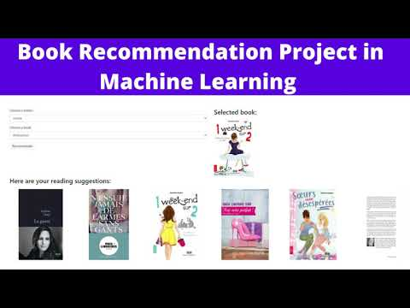
1.INTRODUCE
The research topic is about apply machine learning and deep learning to Recommendation System.

Slide 5


1.INTRODUCE
The main purpose is to build a Recommendation System model based on a simple principle: use "ratings" and "ReviewText" to predict suitable items for customer

Slide 6
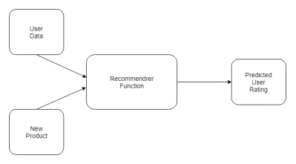
WHAT IS A RECOMMENDATION SYSTEM ?
A recommendation system is a subset of machine learning that uses data to help users find products and content. Websites and streaming services use recommender systems to generate “for you” or “you might also like” pages and content.

Slide 7
HOW DOES IT WORK?
RECOMMENDATION SYSTEMS COLLECT CUSTOMER DATA AND AUTO-ANALYZE IT TO GENERATE CUSTOMIZED RECOMMENDATIONS FOR YOUR CUSTOMERS. THESE SYSTEMS RELY ON BOTH:
IMPLICIT DATA
EXPLICIT DATA

Slide 8

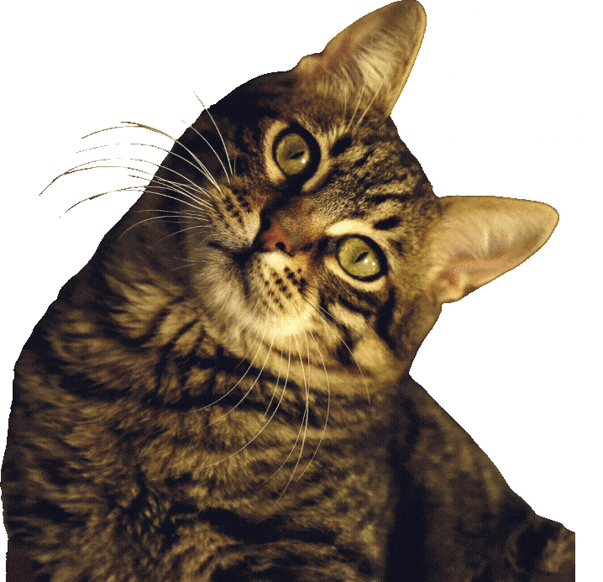
1.INTRODUCE
WHAT PROBLEM CAN SOLVE WITH TOPICS?

Slide 9

1.INTRODUCE
RECOMMENDATION SYSTEM
What recommendation system can solve?
. Increased sales/conversion
Increased user satisfaction
Increased loyalty and share of mind
Reduced churn

Slide 10

ONE LIMITATION OF RECOMMENDER SYSTEMS IS THE LACK OF SUFFICIENT DATA FOR NEW USERS. TO ADDRESS THIS, SHARING USER INFORMATION AMONG NON-COMPETING SITES IN CONSORTIA IS A POTENTIAL SOLUTION.

Slide 11
2.RESEARCH METHODS
Introduction to the steps:
Collecting Data
1
Data Visualization
2
Choosing a Model
3
Applying algorithms
4
Prediction Visulization
5

Slide 12
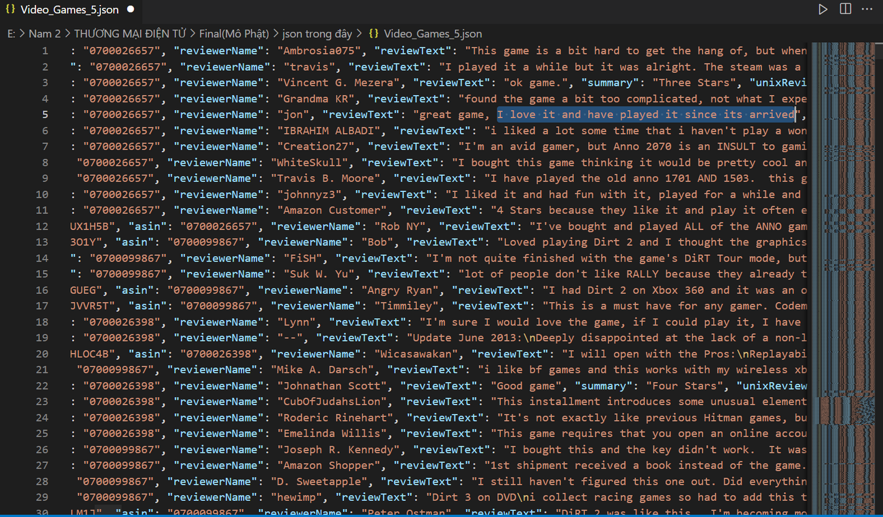
DATA
1.COLECT DATA
AMAZON VIDE0 GAME DATA
AND META DATA
BE USED IN 2 PAPER:
1.HTTPS://CSEWEB.UCSD.EDU/~JMCAULEY/PDFS/WWW16A.PDF
2.HTTPS://CSEWEB.UCSD.EDU/~JMCAULEY/PDFS/SIGIR15.PDF
Source: https://cseweb.ucsd.edu/~jmcauley/datasets.html#amazon_reviews'

Slide 13
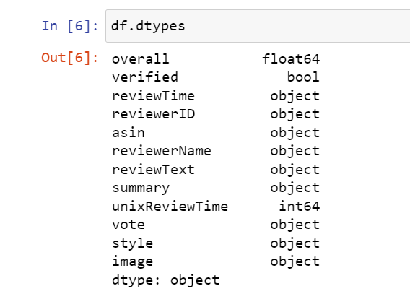
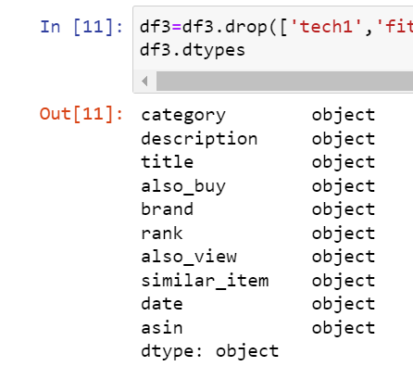
2.READ DATA
VIDEO_GAME_5.JSON
META_VIDEO_GAME_5.JSON
"USE TO TRAIN AND TEST"
"USE ALSO_VIEW AND SIMILAR_ITEM TO CONSIDER THE ACCURACY OF THE PREDICTION
USE TITILE TO DISPLAY PRODUCT NAME "

Slide 14
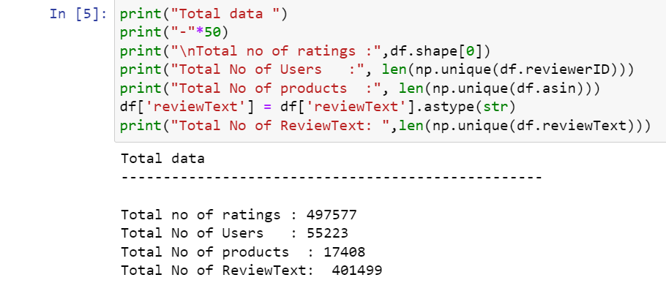
2.READ DATA
TOTAL DATA OF VIDEO_GAME_5.JSON

Slide 15
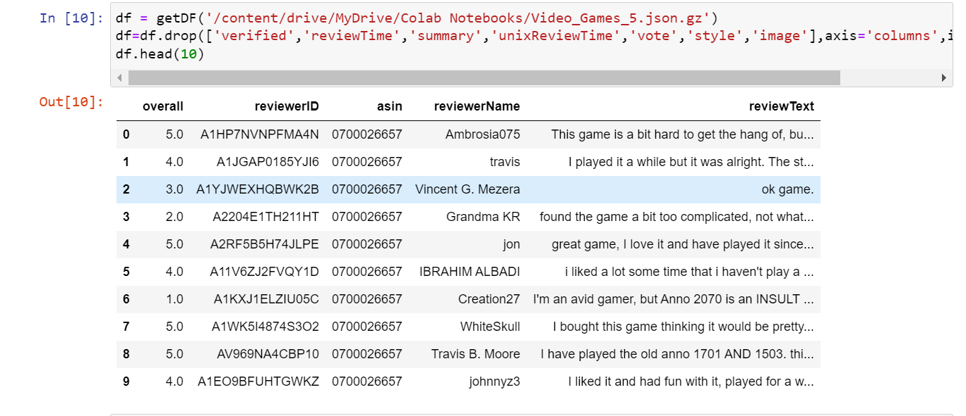
2.READ DATA

Slide 16
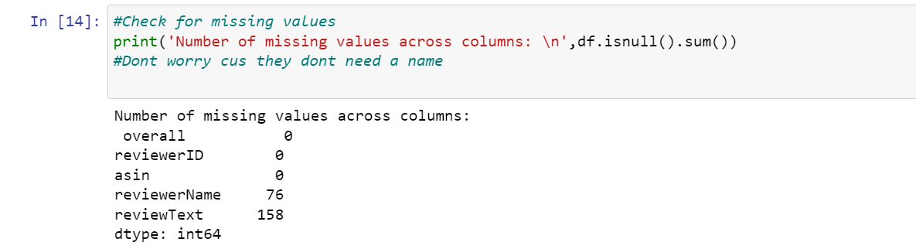

2.READ DATA
TO USE DATA EFFECTIVELY, WE CHECK NULL VALUES OF DATA
ReviewText, reviewerName have null

Slide 17
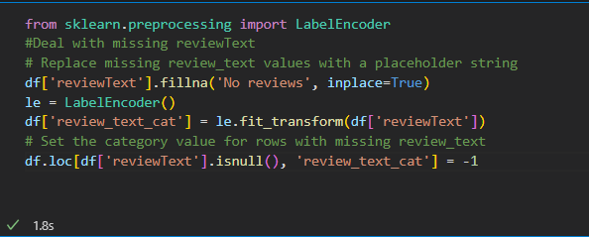
2.READ DATA
REPLACE THE NULL REVIEWTEXT TO:"NO REVIEWS"

Slide 18
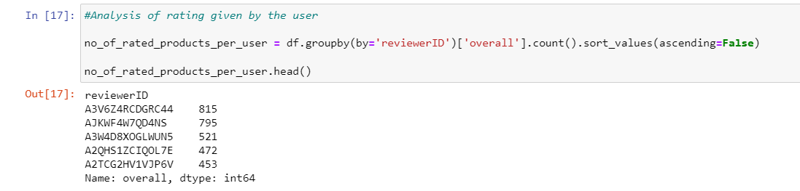
2.READ DATA
see if the number of products that customers experience is suitable for analysis

Slide 19
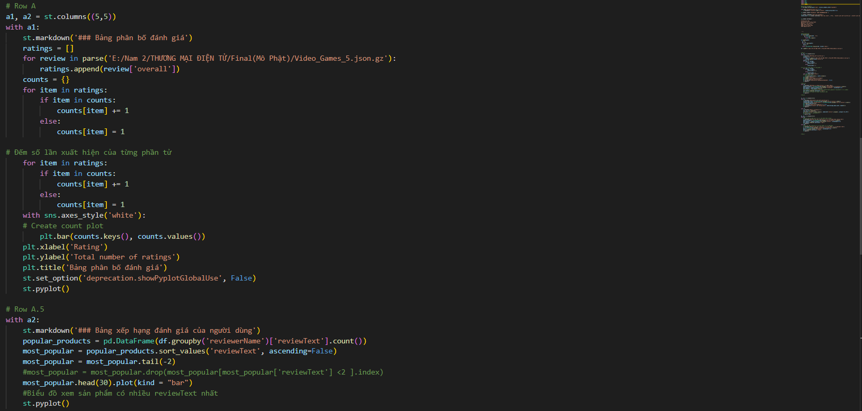
CODE DASHBOARD

Slide 20
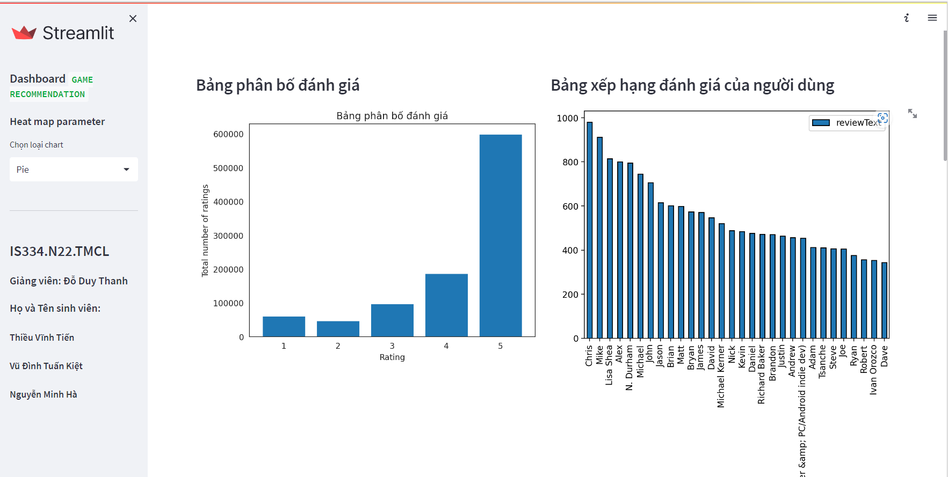
DASHBOARD

Slide 21
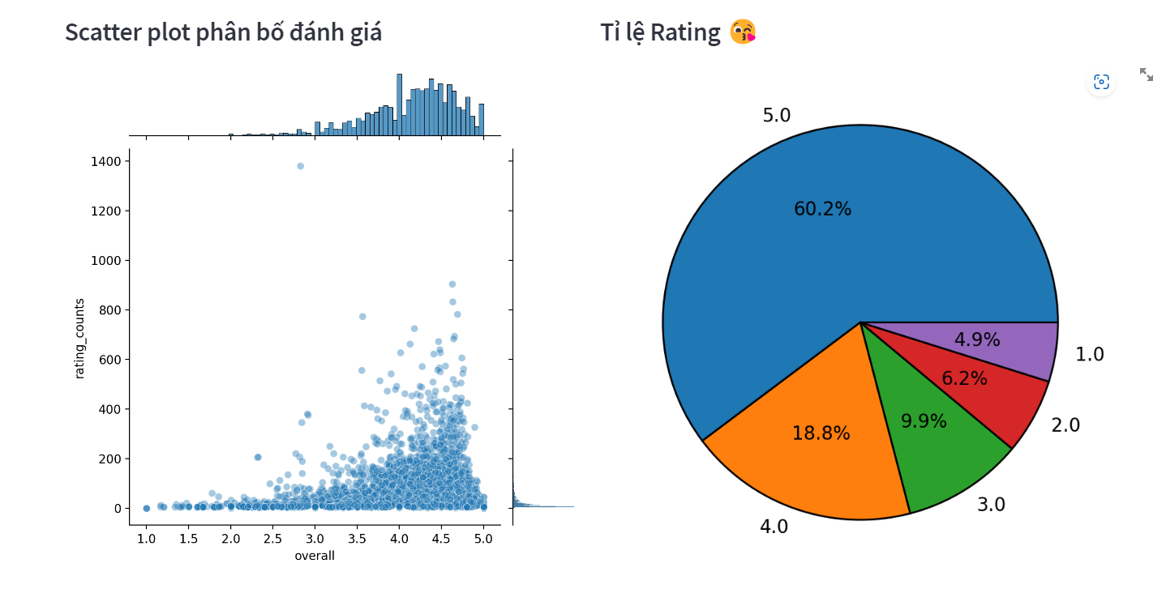
DASHBOARD

Slide 22
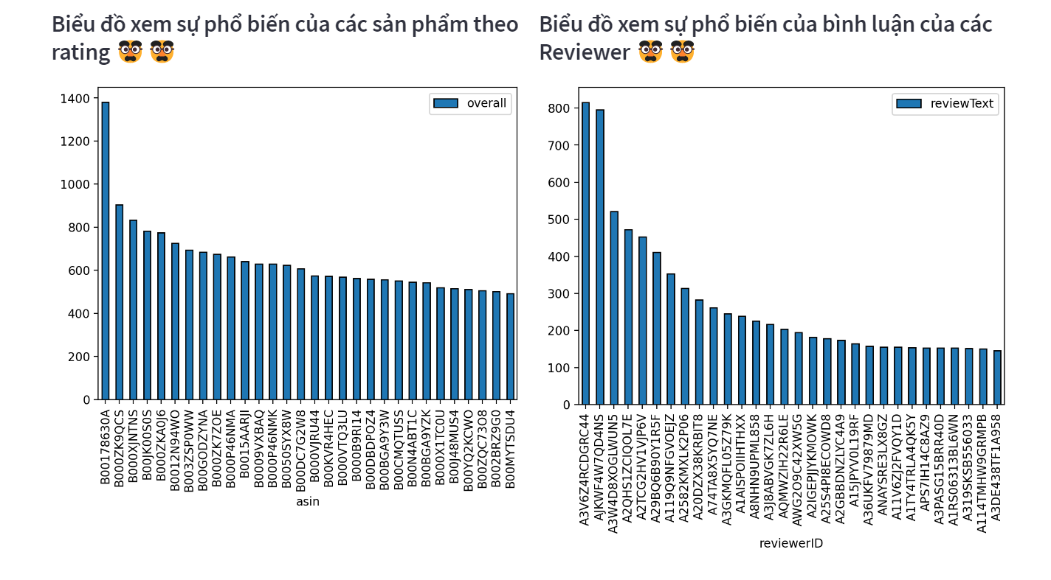
DASHBOARD

Slide 23
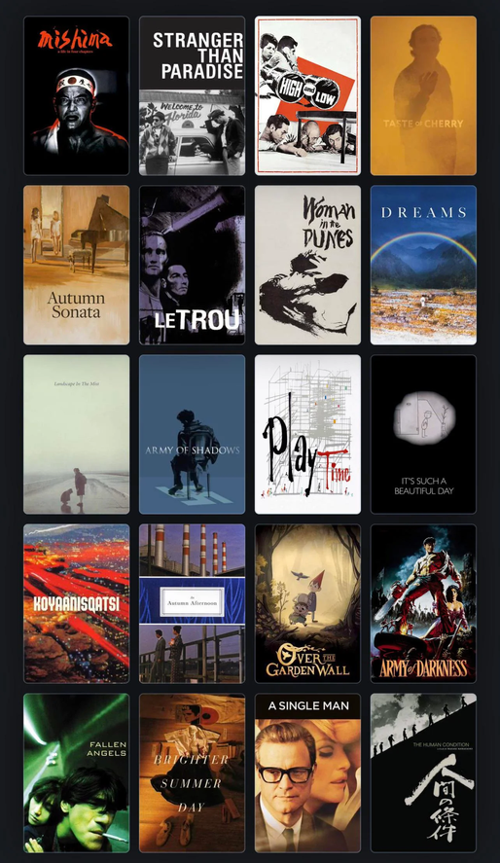

3.THEORETICAL
POPULARITY BASED RECOMMENDATION
Popularity based recommendation system works with the trend. It basically uses the items which are in trend right now.
For example: if any product which is usually bought by every new user then there are chances that it may suggest that item to the user who just signed up.

Slide 24

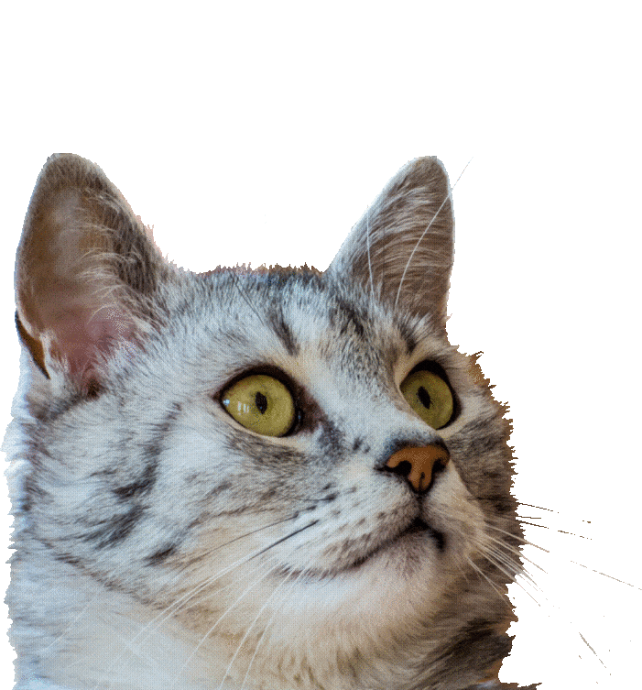
3.THEORETICAL
POPULARITY BASED RECOMMENDATION
The problems with popularity based recommendation system is that the personalization is not available with this method i.e. even though you know the behaviour of the user you cannot recommend items accordingly.

Slide 25
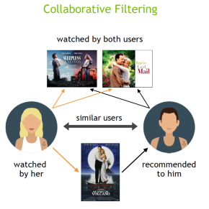
3.THEORETICAL
COLLABERATIVE FILTERING (ITEM-ITEM RECOMMEDATION)
These techniques aim to fill in the missing entries of a user-item association matrix. We are going to use collaborative filtering (CF) approach.
CF is based on the idea that the best recommendations come from people who have similar tastes. In other words, it uses historical item ratings of like-minded people to predict how someone would rate an item.
Collaborative filtering has two sub-categories that are generally called memory based and model-based approaches.

Slide 26
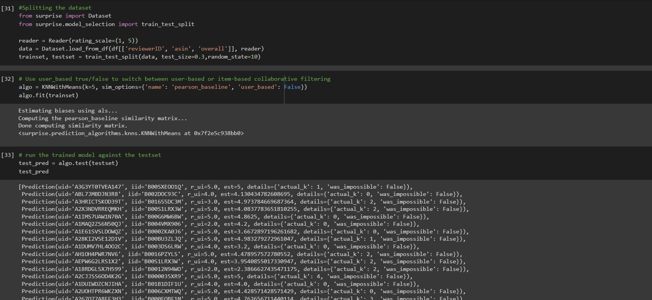
COLLABERATIVE FILTERING (ITEM-ITEM RECOMMEDATION)

Slide 27
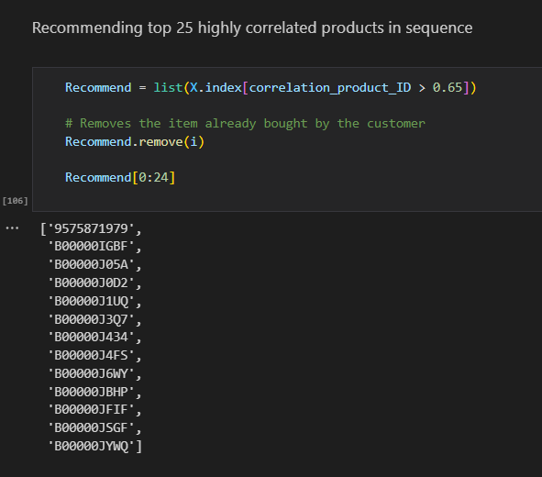
COLLABERATIVE FILTERING (ITEM-ITEM RECOMMEDATION)

Slide 28
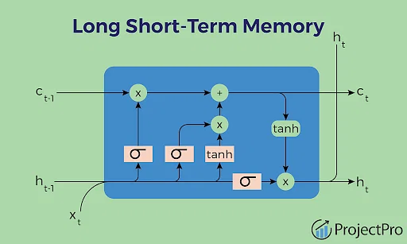
LONG SHORT-TERM MEMORY (LSTM)

Slide 29
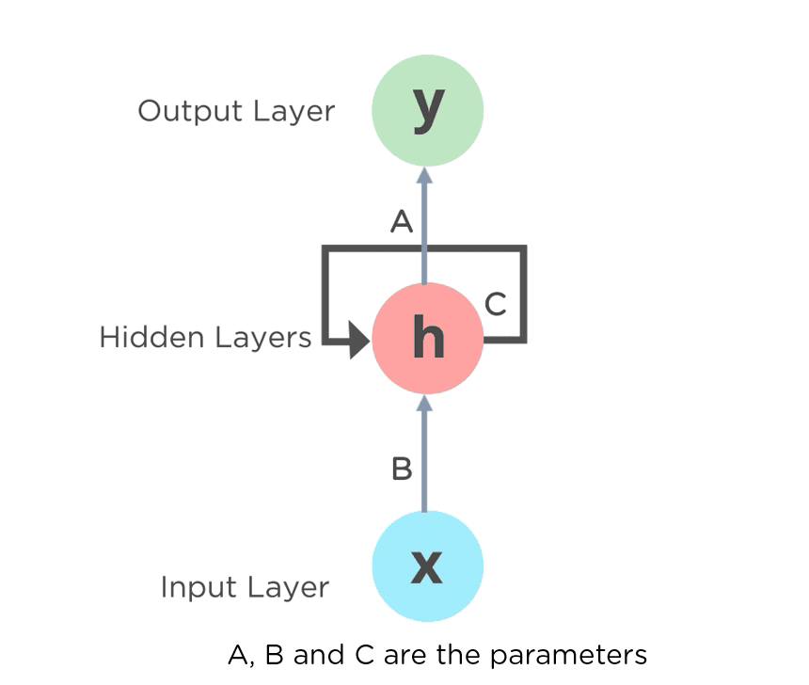
RECURENT NEURAL NETWORK
(RNN)
RNN stands for Recurrent Neural Network. It is a type of artificial neural network that is designed to process sequential data or time series data, where the order of the data points matters.
RNNs have recurrent connections that allow them to maintain a hidden state that can capture information from previous time steps and use it to make predictions or generate output for future time steps.

Slide 30
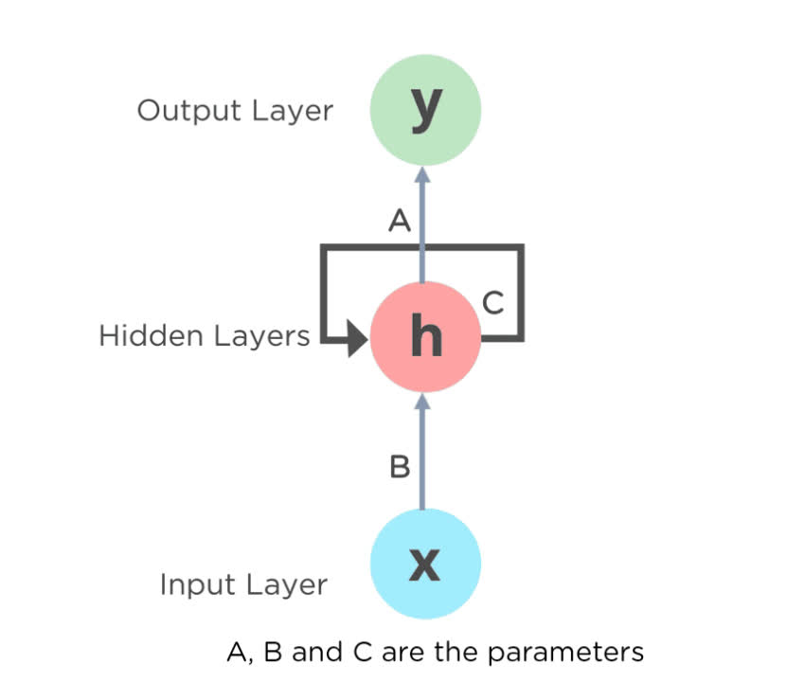
RECURENT NEURAL NETWORK
(RNN)
The hidden layer of a recurrent neural network (RNN) typically consists of recurrent neurons or cells. These neurons receive inputs from the input layer and propagate information across time steps, allowing the network to capture sequential dependencies in the data. The hidden layer is responsible for processing the temporal information and maintaining a memory of the past inputs, which allows the RNN to learn patterns in sequential data.

Slide 31
RECURENT NEURAL NETWORK
(RNN)
THE STEPS OF RUNNING A RECURRENT NEURAL NETWORK (RNN)
Initialize the hidden state
Input data into the RNN
Compute the output
Update the hidden state
Repeat the computation process
Collect the output of the RNN

Slide 32
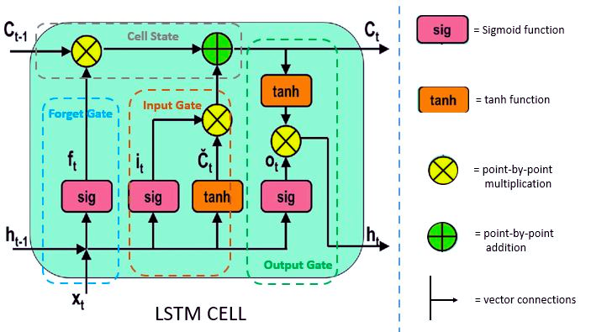
LONG SHORT-TERM MEMORY (LSTM)
LSTM stands for Long Short-Term Memory, and it is a type of recurrent neural network (RNN) architecture that is designed to process sequential data. LSTMs are a type of artificial neural network that are particularly well-suited for handling time-series data, such as speech recognition, natural language processing, and other tasks that involve processing sequences of data points with long-term dependencies.

Slide 33

CODE
HTTPS://COLAB.RESEARCH.GOOGLE.COM/DRIVE/1OKI7VSGWGFV-9WE-MOUX75K5ZXJELFSU

Slide 34
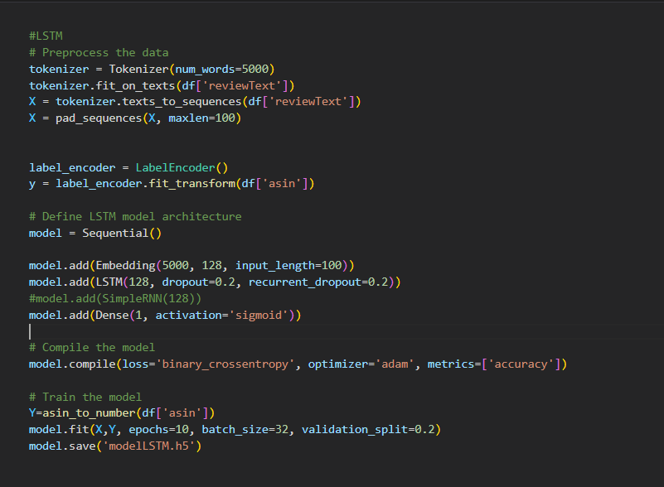
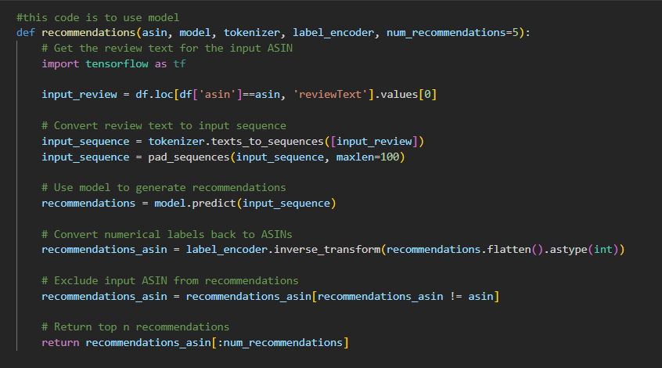
LONG SHORT-TERM MEMORY (LSTM)

Slide 35
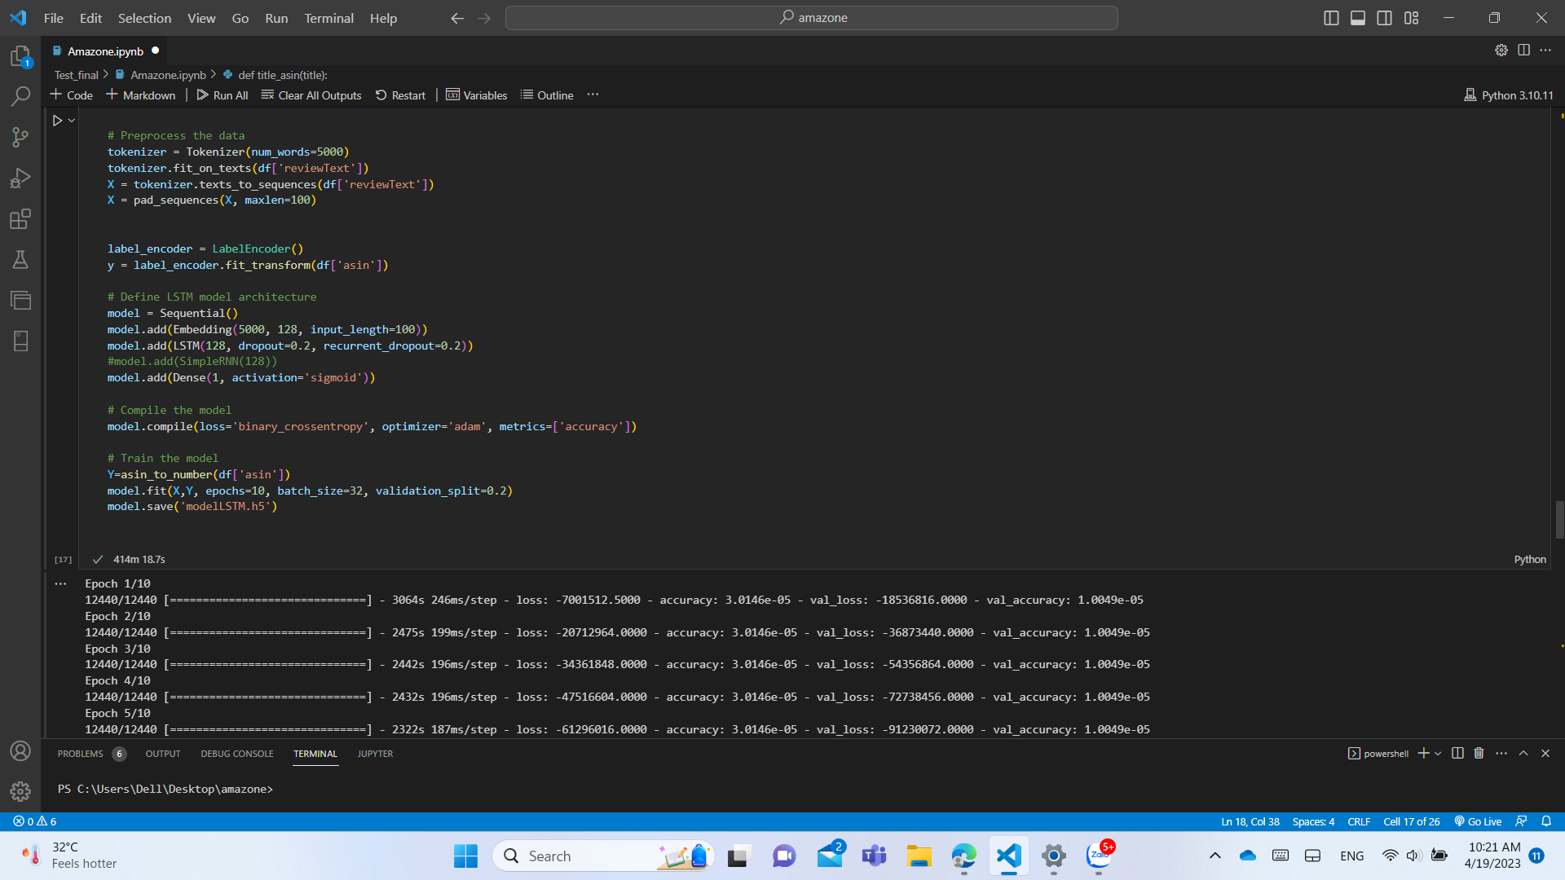

Slide 36
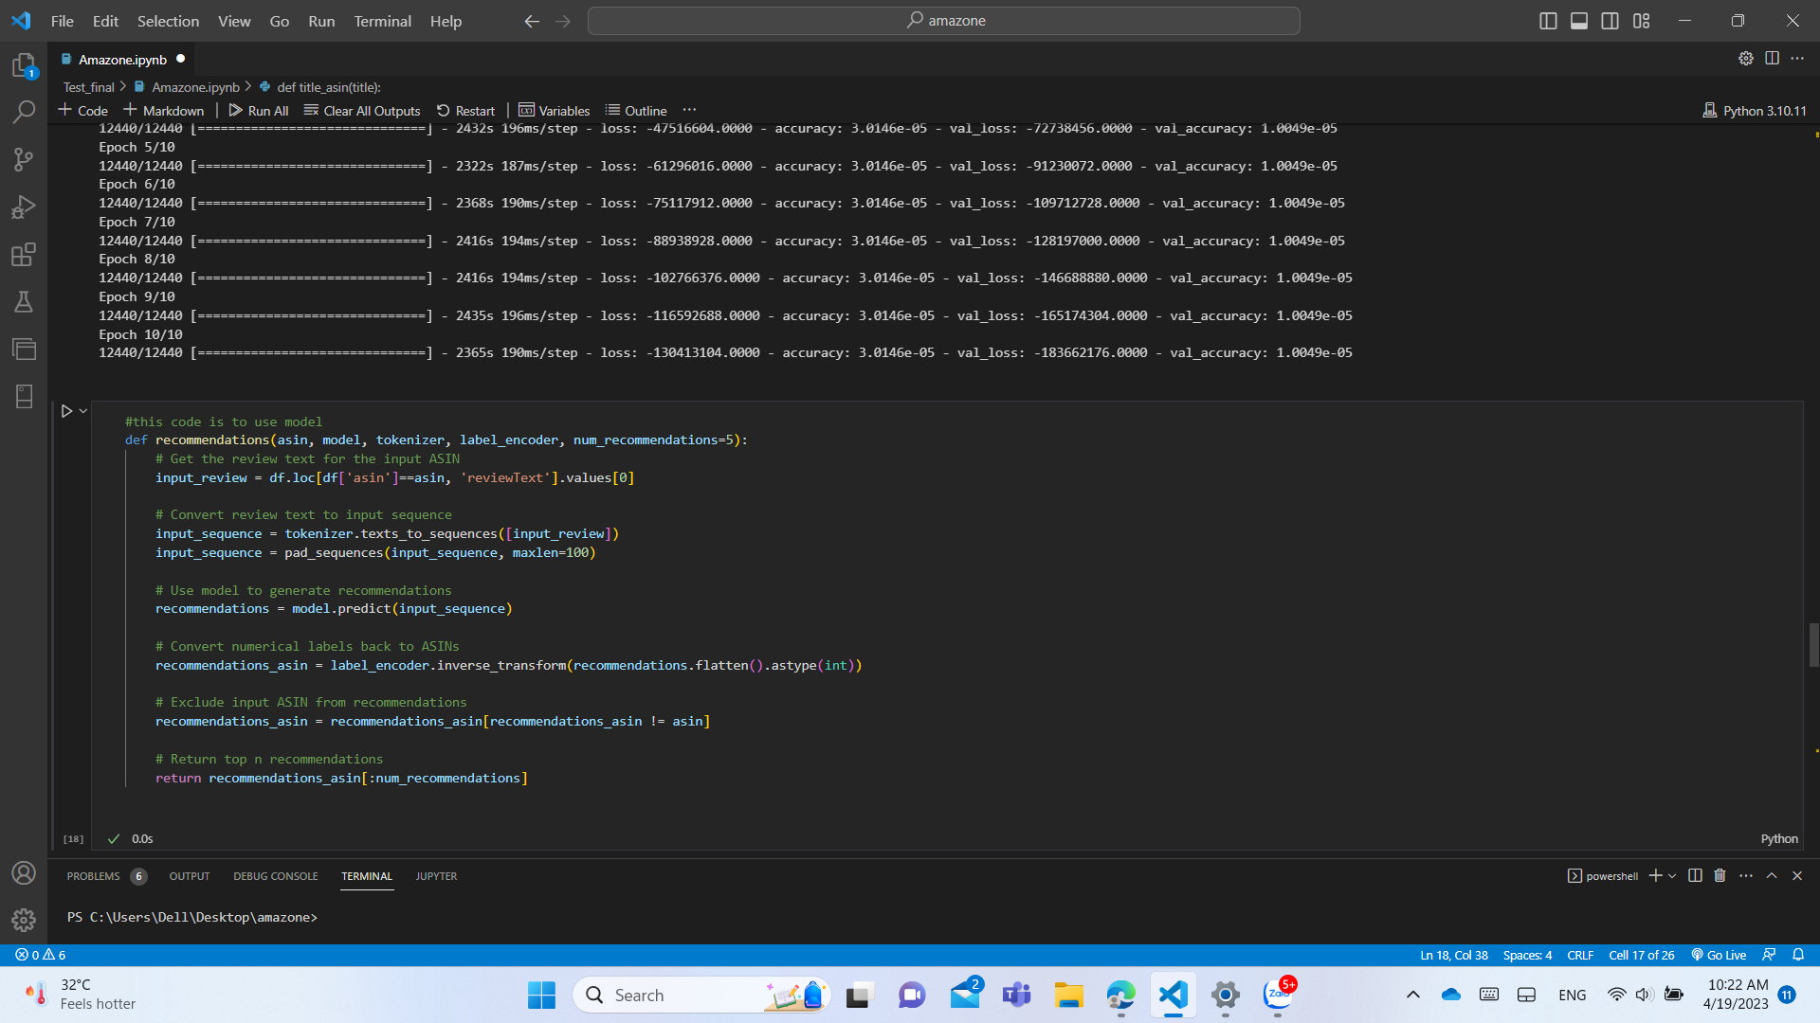

Slide 37
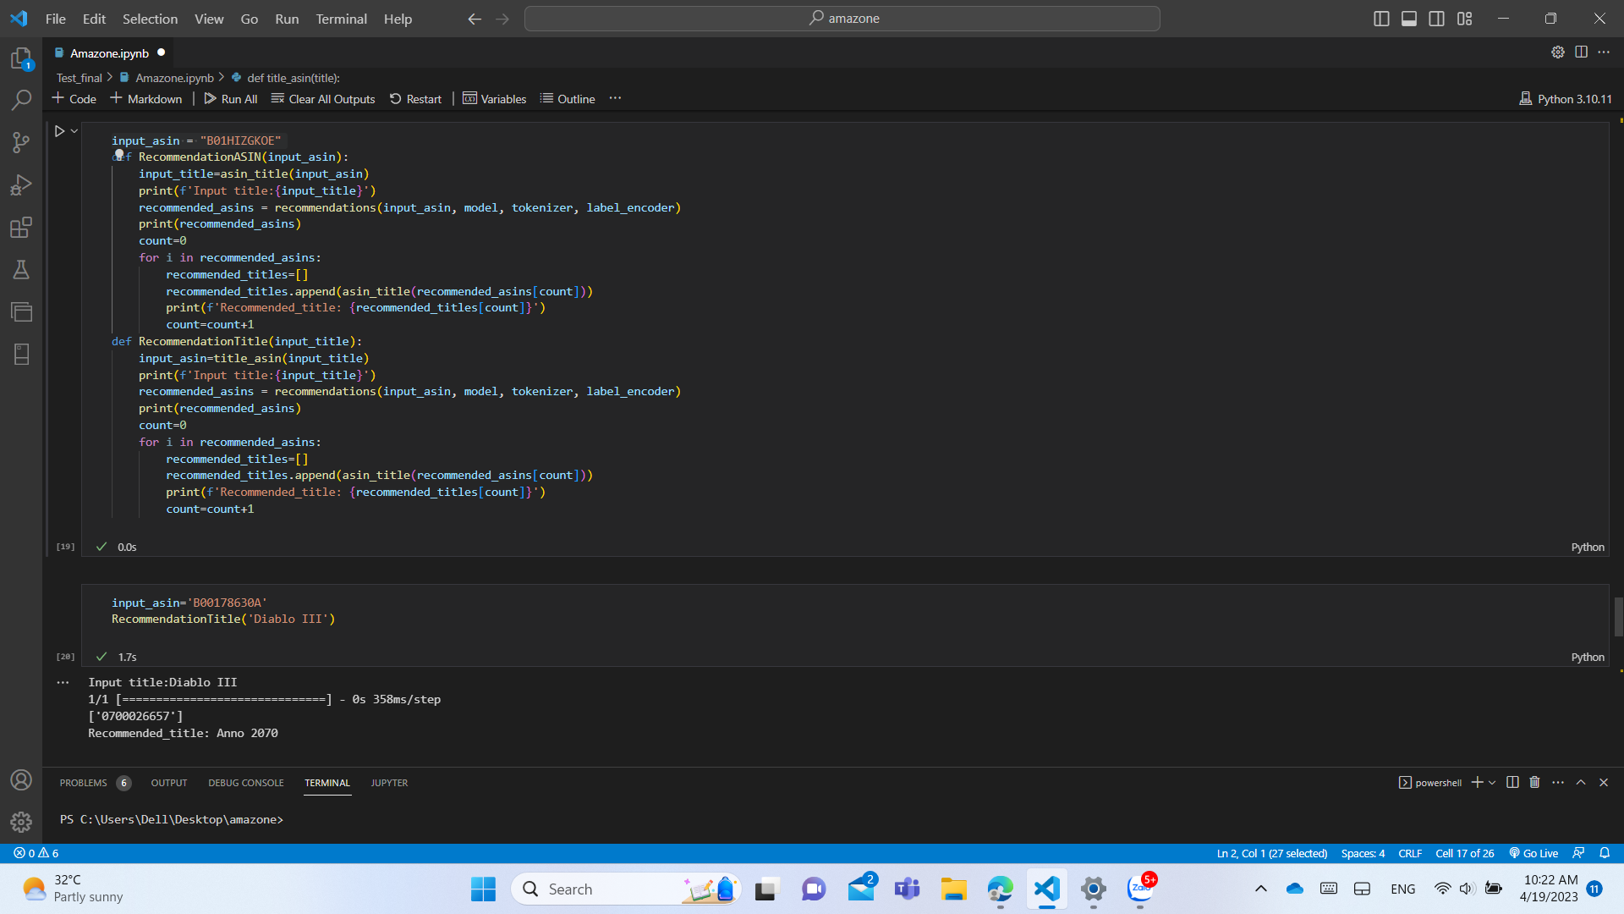

Slide 38
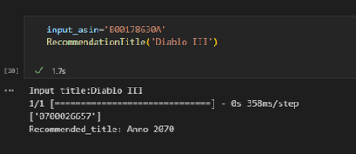

Slide 39
REFERENCE
JUSTIFYING RECOMMENDATIONS USING DISTANTLY-LABELED REVIEWS AND FINED-GRAINED ASPECTS
Jianmo Ni, Jiacheng Li, Julian McAuley
Empirical Methods in Natural Language Processing (EMNLP), 2019
2. (418) LONG SHORT-TERM MEMORY (LSTM), CLEARLY EXPLAINED - YOUTUBE
3. (418) RECURRENT NEURAL NETWORKS (RNNS), CLEARLY EXPLAINED!!! - YOUTUBE
4. AMAZON PRODUCT REVIEWS | KAGGLE
5. UPS AND DOWNS: MODELING THE VISUAL EVOLUTION OF FASHION TRENDS WITH ONE-CLASS COLLABORATIVE FILTERING
R. HE, J. MCAULEY
WWW, 2016
6. IMAGE-BASED RECOMMENDATIONS ON STYLES AND SUBSTITUTES
J. MCAULEY, C. TARGETT, J. SHI, A. VAN DEN HENGEL
SIGIR, 2015

Slide 40
LINK YOUTUBE
HTTPS://YOUTU.BE/FA8K_3FYVTY

Slide 41
THANK YOU

